Slide 1


Intelligence Analysis through an Ontological Lens
John Beverley
Assistant Professor, University at Buffalo
Co-Director, National Center for Ontological Research
Affiliate Faculty, Institute of Artificial Intelligence and Data Science

Slide 2
Outline
Intelligence Analysis on the Ground
Conceptual Foundations
Analytical Toolkit

Slide 3
Outline
Intelligence Analysis on the Ground
Conceptual Foundations
Analytical Toolkit

Slide 4
Battle of Cannae
216 BCE Second Punic War
Romans raised an army of ~70,000 troops to push Hannibal from the pennisula, some of whom were Celtic warriors from nearby regions
Some of whom were spies for Hannibal...

Slide 5
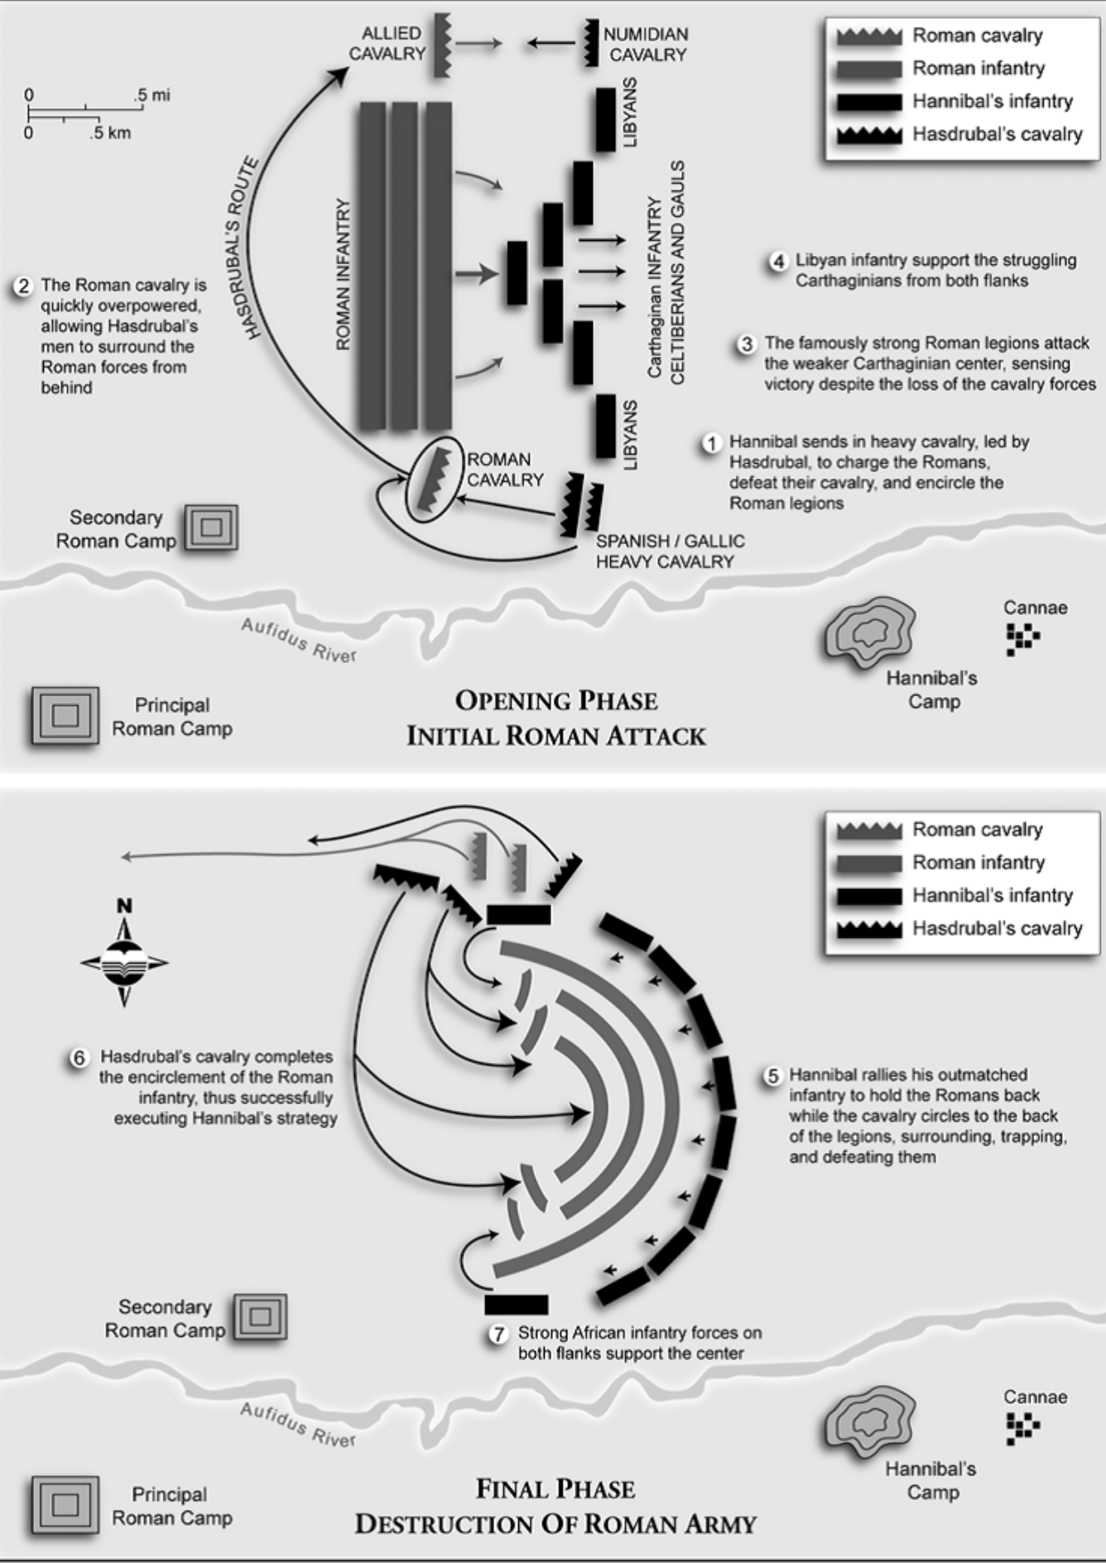
Battle of Cannae
Romans had experienced soldiers push through the center of Hannibal’s troops, with the goal of splitting his army
Hannibal placed weakest troops in the center, flanked by elite troops

Slide 6
Battle of Cannae
As the Romans pushed the center, Hannibal’s weakest troops gave ground and the elite troops moved to encircle the Roman army
60,000 Roman soldiers were killed in this battle
~20% of adult male Roman population

Slide 7
Japan Invades the Philippines
1942 during World War II, just after the U.S. had entered the war
Douglas MacArthur, commander of the United States Armed Forces in the Far East, stationed in the Philippines, was forced to retreat
Long-term strategic planning by Japanese military resulted in spies infilitrating U.S. and Philippine organizations
For example, it is reported that a gardner for the Philippine governor was a high-ranking Japanese military officer

Slide 8
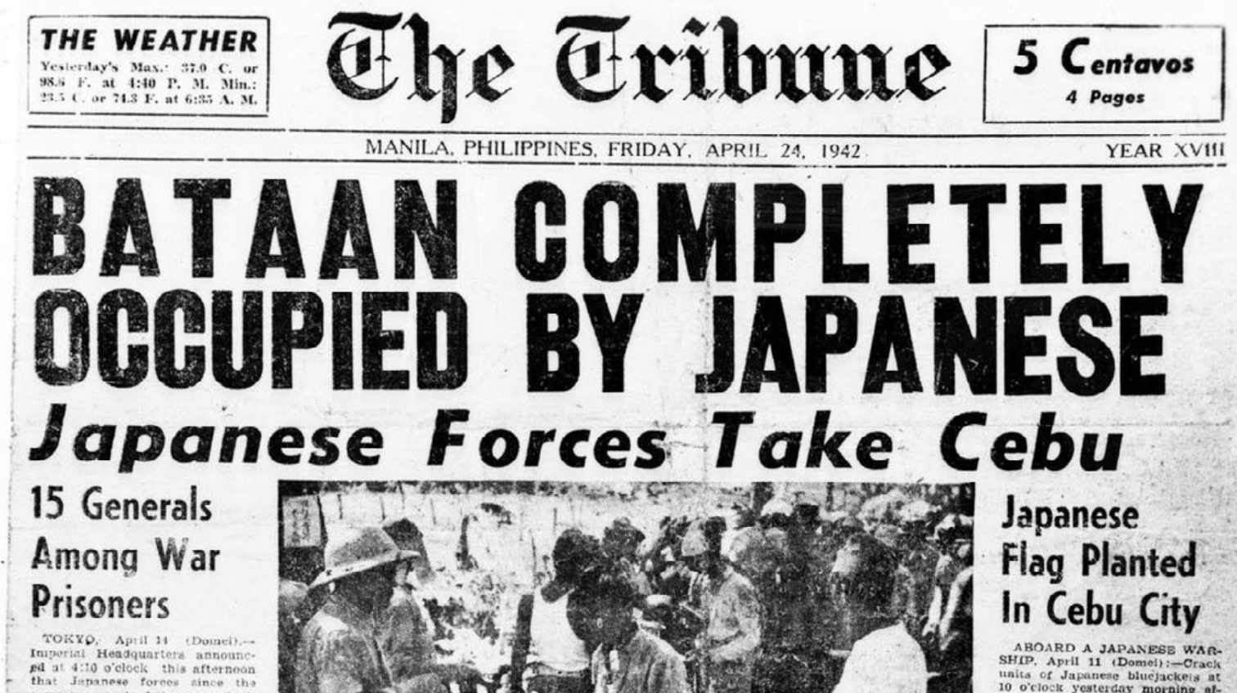

Slide 9
Double-Edged Sword
These examples illustrate both intelligence analysis failures and successes
The failure of Roman consuls to acquire and leverage intelligence while battling Hannibal was compounded by Hannibal’s proclivity for leveraging intelligence
The intelligence failures of the U.S. and Philippine military forces were magnified by the superior intelligence strategies deployed by the Japanese

Slide 10
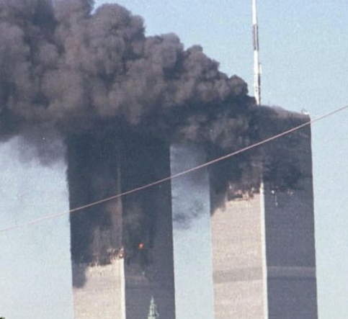
9/11
2001, four U.S. commercial airplanes were hijacked by members of Al-Queda intending to crash them into the Twin Towers, the Pentagon, and Washington D.C.
All were successful with the exception of the planned crash in D.C.
The Twin Towers collapsed; nearly 3,000 people were killed in the attacks

Slide 11
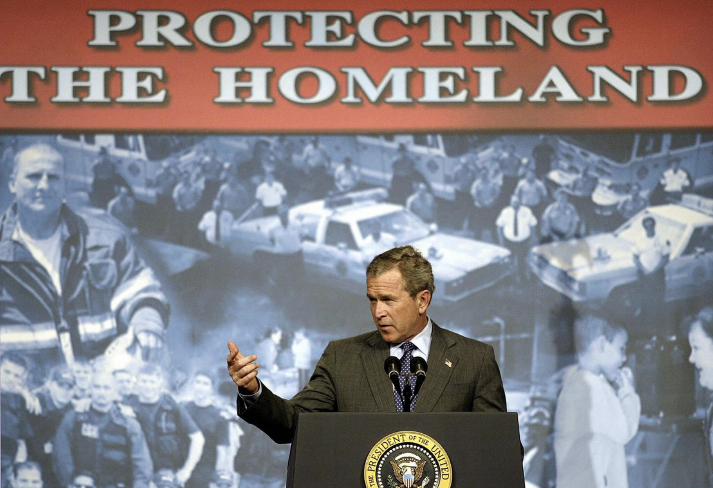
9/11
Resulting investigations revealed U.S. intelligence agencies knew Al-Queda was mobilizing,but information was not shared freely across agencies
At the time the NSA considered itself an intelligence curator; if an agency asked whether Al-Queda was mobilizing, they’d confirm
Few people knew to ask...

Slide 12

Double-Edged Sword
The 9/11 attacks were magnified by failures of intelligence sharing across U.S. government agencies
The U.S. government established the Patriot Act to ensure such failures did not happen again
Expanding surveillance capabilities of law enforcement and easing information flow between agencies

Slide 13
Group Exercise
Gather into small groups and select one of the cases that I have described
I would like your group to develop an understanding of the intelligence successes and failures exibited in that case in some detail
Importantly, you should engage in intelligence gathering of your own if you are unfamiliar with a case
Groups exploring the same case will be asked to compare intel

Slide 14
Outline
Intelligence Analysis on the Ground
Conceptual Foundations
Analytical Toolkit

Slide 15
Clarifying our Teams
“Intelligence” is spoken of in many ways
Entities can be considered intelligent, e.g. Einstein, Aristotle, Fido the dog, Hal the computer
Or exhibit intelligence, e.g. performing well on an exam, read a defense, offer a quick quip
Activities can be considered intelligent as well, e.g. chess strategy, Hannibal’s encirclement strategy

Slide 16
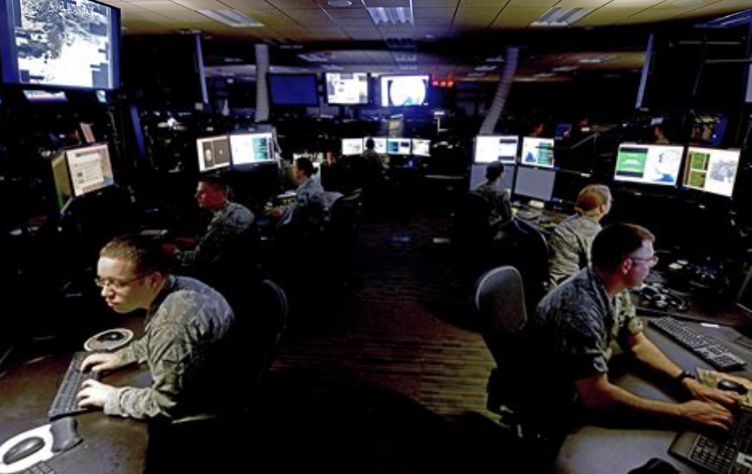
Clarifying our Teams
We can also distinguish intelligence as:
Information
Product of intelligence activities
Activities themselves
Across numerous domains:
Criminals
Law Enforcement
Armed Forces
Corporations
Non-profits
You

Slide 17
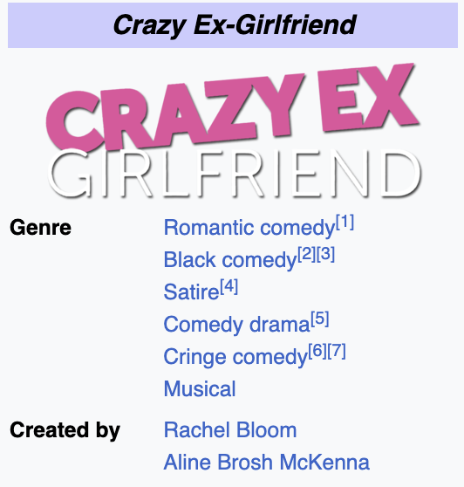

Clarifying our Teams
We can also distinguish intelligence as:
Information
Product of intelligence activities
Activities themselves
Across numerous domains:
Criminals
Law Enforcement
Armed Forces
Corporations
Non-profits
You

Slide 18
Evidence & Risky Arguments
Among the goals of intelligence analysis is to provide justification for conclusions drawn from investigations
Valid arguments are such that if the premises are true then so is the conclusion, i.e. “no risk”
This often takes the form of what we might call “risky” arguments

Slide 19
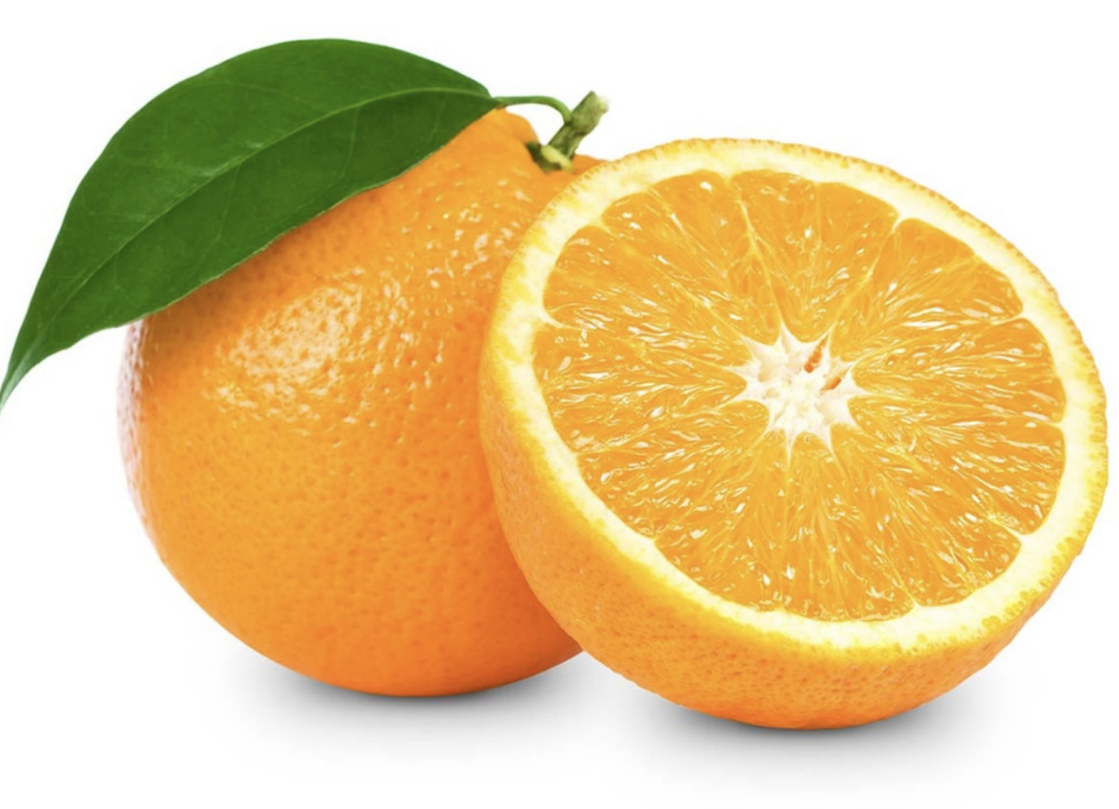
Sampling
(1) There are 20 oranges in this bag
(2) 12 oranges have been inspected and are delicious
(3) Hence, most of the other 8 oranges in the bag will be delicious

Slide 20
Sampling
(1) There are 20 oranges in this bag
(2) 12 oranges have been inspected and are delicious
(3) Hence, most of the other 8 oranges in the bag will be delicious
There are 20 oranges in this bag
This randomly chosen orange is delicious
Hence, most of the remaining 19 oranges will be delicious

Slide 21
Proportions
We can be more precise…
What does “most” mean in “most of the oranges in the bag will be delicious”
>90% ?
>80% ?
>50% ?

Slide 22
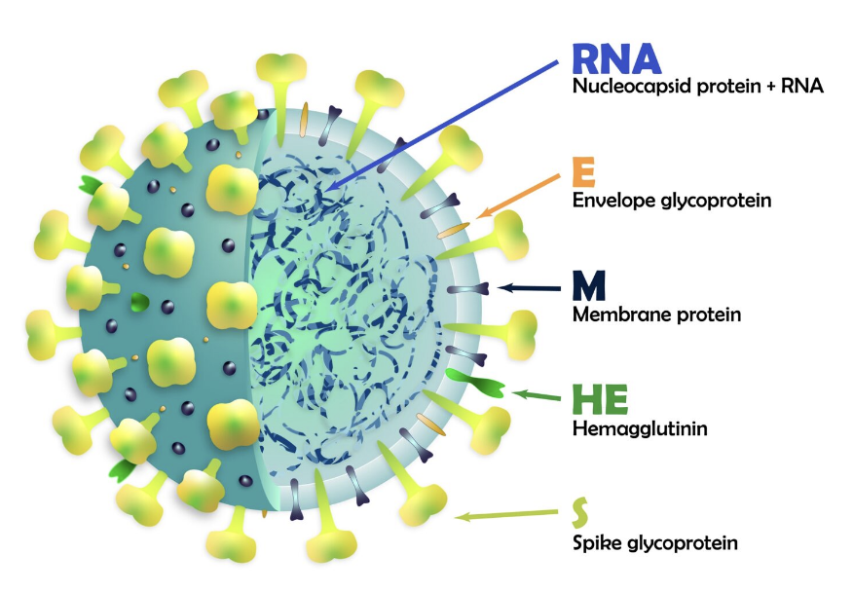
Proportions
Note, this might changes based on context
What does “most” mean in “most people in the U.S. will be infected by SARS-CoV-2”
>90% ?
>80% ?
>50% ?

Slide 23
Proportions
(1) There are 20 oranges in this bag
(2) 12 oranges have been inspected and are delicious
(3) Hence, most of the other 8 oranges in the bag will be delicious
There are 20 oranges in this bag
This randomly chosen orange is delicious
Hence, most of the remaining 19 oranges will be delicious

Slide 24
Proportions
(1) There are 20 oranges in this bag
(2) 12 oranges have been inspected and are delicious
(3) Hence, > 6 oranges in the bag will be delicious
There are 20 oranges in this bag
This randomly chosen orange is delicious
Hence, > 16 oranges will be delicious

Slide 25
Predictions
Researchers often look towards the future, making risky claims – or predictions - about what might happen
For example, researchers predict that at our current rate of carbon emissions we might not be making predictions in the future…
Analysts may predict that at our current rate of artificial intelligence research, the U.S. will soon fall behind other nations

Slide 26
Retrodiction
Not all risky arguments concern samples and inferences to populations
Analysts often make retrodictions or hypotheses about what’s happed in the past
For example, physicists believe our universe began with a “Big Bang”
Analysts may, as another example, believe 9/11 was precipitated by the first war in Iraq

Slide 27
Explanations
Researchers also produce explanations, or plausible links between retrodictions and predictions, supported by data
Einstein reviewed data concerning light, fundamental particles, and gravity, alongside predictions being made by physicists of his time
Before providing a unifying explanation for the data, leading to a different set of predictions that avoided problems

Slide 28
Altogether
Retrodiction
Explanation
Prediction

Slide 29
Altogether
Retrodiction
Explanation
Prediction

Slide 30
Altogether
Retrodiction
Explanation
Prediction

Slide 31
Altogether
Retrodiction
Explanation
Prediction

Slide 32
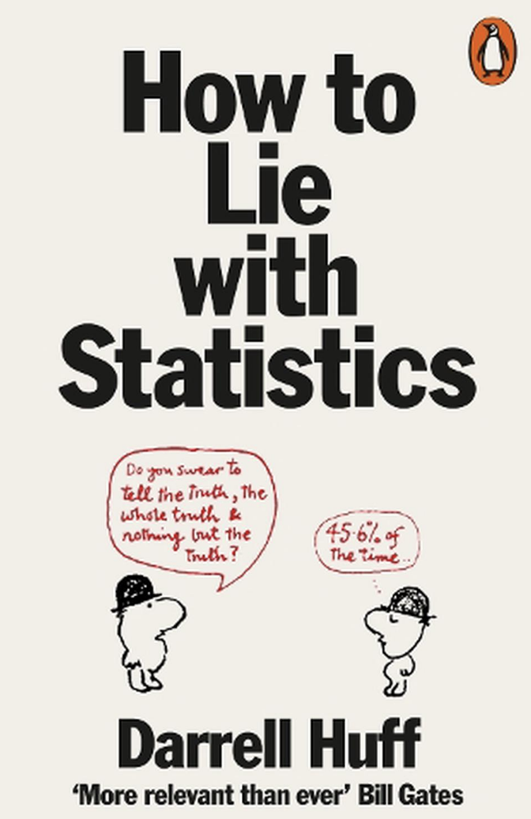
Evidence & Context
Intelligence gathering and its products aim to acquire justified beliefs
Raw data on its own may seem sensational and, consequently, attractive to policy makers...
Analysts must provide context and support for conclusions drawn

Slide 33

Sensational Truth
Consider the 1985 graduating class of the University of North Carolina
Which graduates do you think had the highest average starting salary?

Slide 34

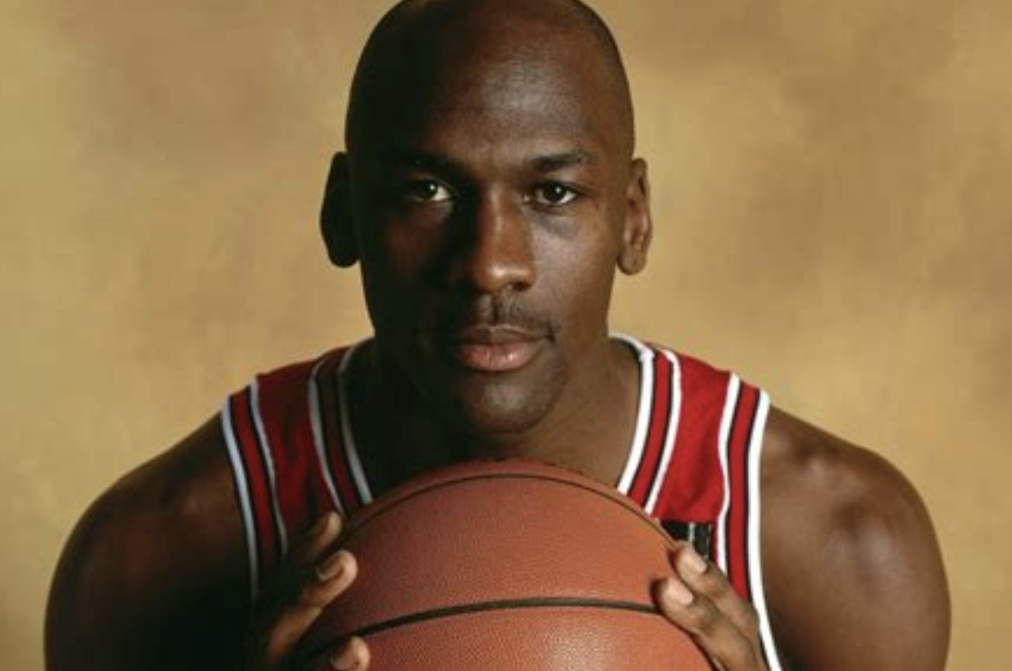
Sensational Truth
Whatever your guess, I bet it wasn’t cultural geography at $250,000
Michael Jordan graduated that year with a degree in cultural geography, and a starting salary of $700,000 per year

Slide 35
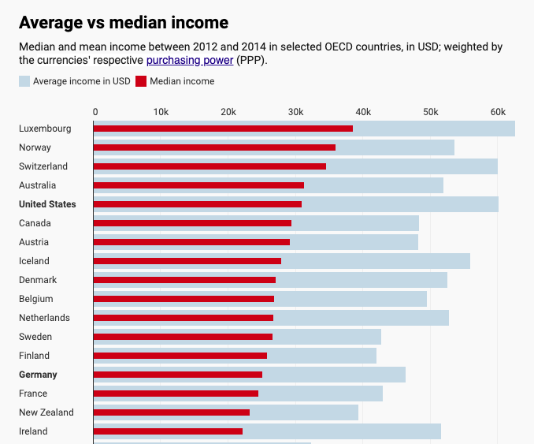
Outliers skew the mean, e.g.
Bezos, Musk, Buffett

Slide 36
Causation and Correlation
Here’s a surprising fact that mainstream media doesn’t seem to want you to know
There is a strong correlation between the rising global average temperature…
And the decrease in the number of pirates occupying global waters

Slide 37
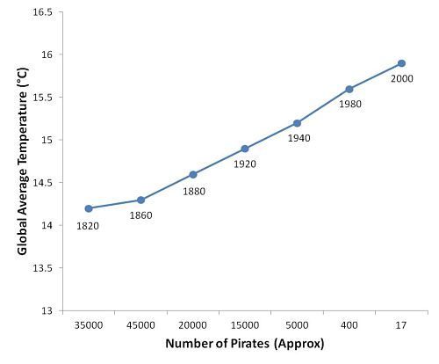




Slide 38


Slide 41
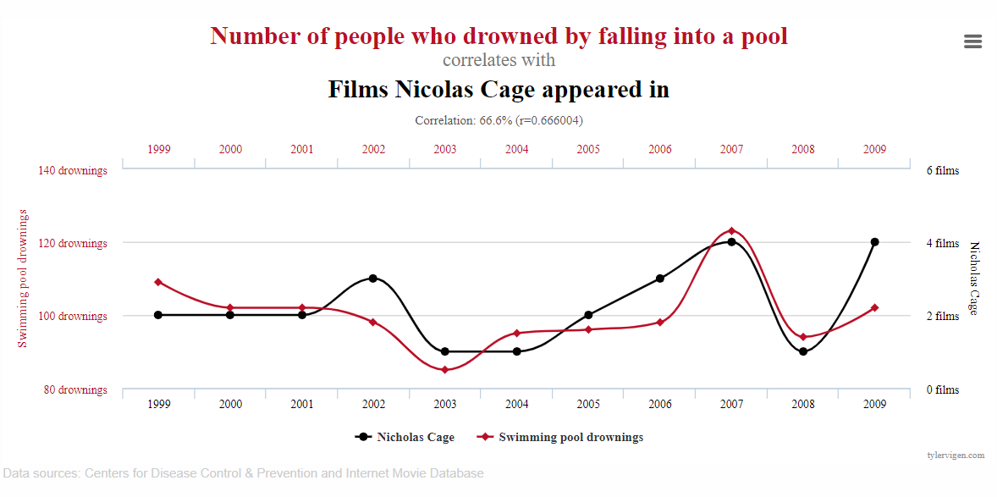
Causation and Correlation
Causation is not correlation
Correlations are – simply put – everywhere, but causation is a bit rarer

Slide 42
Causation and Correlation
Causation is not correlation
Correlations are – simply put – everywhere, but causation is a bit rarer
https://www.tylervigen.com/spurious-correlations

Slide 43
Secrecy
Intelligence appears to crucially involve some manner of secrecy
Following 9/11 when a U.S. Senator revealed to the press that the phones of members of Al-Queda were being tracked by U.S. authorities, Al-Queda switched carriers
The covert nature of intelligence gathering is what seems to distinguish it from simply seeking justified beliefs

Slide 44
Preliminary Intelligence Definitions
Intelligence =_{def} Evidence acquired to justify beliefs obtained through intelligence gathering
Intelligence gathering =_{def} Covert behavior aimed at acquiring information to promote the interests of an individual or collective, using methods deemed reliable by the individual or collective

Slide 45
Group Exercise
Gather into small groups and reflect on the definitions of intelligence and intelligence gathering presented
In light of your earlier research and the motivations I’ve given here, I would like to you investigate the plausibility of these definitions
Because they are definitions, the left-hand side of the “=_{def}” accurately applies to some phenomena just in case the right-hand side does

Slide 46
Evidence vs Information
What distinguishes evidence from information?
Presumably, evidence is a type of information that supports or provides justification for some belief
However, not all information is evidence

Slide 47
Truth-Seeking
The readings and our scenarios suggest that truth is ultimate and appropriate goal for the intelligence analyst
We have described intelligence gathering as, after all, seeking justified beliefs, and this goal is intimately connected with truth
But truth may be detrimental to intelligence gathering and intelligence:
Seeking truth may undermine crucial, immediate goals
Presenting a truth now may prevent presentations of truth later
A gven truth may be misunderstood when nearby falsehoods are not

Slide 48
Summary
We have worked our way to definitions for “intelligence” and “intelligence gathering”
And in passing, discussed important features of intelligence analysis:
Evidence & Risky Arguments
Sampling & Proportions
Retrodiction, Prediction, & Explanation
Contextualizing Raw Information
Secrecy

Slide 49
Outline
Intelligence Analysis on the Ground
Conceptual Foundations
Analytical Toolkit

Slide 50
Knowledge
Knowledge is factive, i.e. if S knows P then P is true
Knowledge is not certainty
Knowledge is not just being in position to know
Knowledge is not merely justified, true, belief

Slide 51
Pragmatic Encroachment
It seems plausible that your environment may affect whether you know or are in a position to know or have justified belief in some content
Pragmatic Encroachment is a thesis in epistemology that maintains differences in pragmatic environment may constitute differences in knowledge

Slide 52
Low Stakes
Hannah and her wife Sarah are driving home on a Friday afternoon. They plan to stop at the bank on the way home to deposit their paychecks. It is not important that they do so, as they have no impending bills. But as they drive past the bank, they notice that the lines inside are very long, as they often are on Friday afternoons. Realizing that it wasn’t very important that their paychecks are deposited right away, Hannah says, “I know the bank will be open tomorrow, since I was there just two weeks ago on Saturday morning. So we can deposit our paychecks tomorrow morning”.

Slide 53
Low Stakes
Hannah and her wife Sarah are driving home on a Friday afternoon. They plan to stop at the bank on the way home to deposit their paychecks. It is not important that they do so, as they have no impending bills. But as they drive past the bank, they notice that the lines inside are very long, as they often are on Friday afternoons. Realizing that it wasn’t very important that their paychecks are deposited right away, Hannah says, “I know the bank will be open tomorrow, since I was there just two weeks ago on Saturday morning. So we can deposit our paychecks tomorrow morning”.
Hannah seems to know the bank will be open

Slide 54
High Stakes
Hannah and her wife Sarah are driving home on a Friday afternoon. They plan to stop at the bank on the way home to deposit their paychecks. Since they have an impending bill coming due, and very little in their account, it is very important that they deposit their paychecks by Saturday. Hannah notes that she was at the bank two weeks before on a Saturday morning, and it was open. But, as Sarah points out, banks do change their hours. Hannah says, “I guess you’re right. I don’t know that the bank will be open tomorrow”.
Hannah does not see to know the bank will be open

Slide 55
Group Exercise
Gather into small groups and reflect on pragmatic encroachment in the context of intelligence gathering
In partcular, I would like you to construct a pair of cases relevant to intelligence analyis but exhibiting differing stakes, where in one case an agent seems to have knowledge or justified belief but in the other they do not
We will discuss these cases as a group

Slide 56
Epistemic Defeaters
A defeater for a belief or knowledge is evidence that the belief or knowledge is false
A rebutting defeater for proposition P is evidence that ~P is true, e.g. the belief that it is not snowing in Buffalo is rebutted by walking outside
An undercutting defeater for P is evidence against P but not evidence for ~P, e.g. the belief that it is not snowing would be undercut by recognition that one had ingested psychodelics

Slide 57
Normative Defeaters
A proposition Q is a normative defeater for a subject’s belief that P iff:
S has evidence that justifies believing Q
Q would be an epistemic defeater for S’s belief that P if S were to believe that Q
S ought to believe Q

Slide 58
Normative Defeaters
Alice is incorrectly told by an otherwise reliable optometrist that her vision is nearly completely unreliable. She refuses to accept his diagnosis without having any rational basis for doing so. As Alice is walking out of the doctor’s office, she sees a car accident and forms the corresponding true belief that there was such an accident.
Though the optometrist's report is false, given all of the evidence that she has available to her, Alice should accept his diagnosis.
Alice has evidence that justifies believing her vision is unreliable

Slide 59
Normative Defeaters
Alice is incorrectly told by an otherwise reliable optometrist that her vision is nearly completely unreliable. She refuses to accept his diagnosis without having any rational basis for doing so. As Alice is walking out of the doctor’s office, she sees a car accident and forms the corresponding true belief that there was such an accident.
Though the optometrist's report is false, given all of the evidence that she has available to her, Alice should accept his diagnosis.
Alice has evidence that justifies believing her vision is unreliable
Alice’s vision being unreliable would be an epistemic defeater

Slide 60
Normative Defeaters
Alice is incorrectly told by an otherwise reliable optometrist that her vision is nearly completely unreliable. She refuses to accept his diagnosis without having any rational basis for doing so. As Alice is walking out of the doctor’s office, she sees a car accident and forms the corresponding true belief that there was such an accident.
Though the optometrist's report is false, given all of the evidence that she has available to her, Alice should accept his diagnosis.
Alice has evidence that justifies believing her vision is unreliable
Alice’s vision being unreliable would be an epistemic defeater
She ought to believe her vision is unreliable

Slide 61
Normative Defeaters
Alice is incorrectly told by an otherwise reliable optometrist that her vision is nearly completely unreliable. She refuses to accept his diagnosis without having any rational basis for doing so. As Alice is walking out of the doctor’s office, she sees a car accident and forms the corresponding true belief that there was such an accident.
Though the optometrist's report is false, given all of the evidence that she has available to her, Alice should accept his diagnosis.
Allice has a normative defeater for believing her vision is reliable

Slide 62
Group Exercise
Gather into small groups and reflect on epistemic and normative defeaters in the context of intelligence gathering
In particular, I would like you to construct three cases within the scope of intelligence analysis, each exhibiting a rebutting, undercutting, or normative defeater
We will discuss these cases as a group

Slide 63





Epistemic Communities
Intelligence analysis is often conducted within an epistemic community
Such communities often share:
Normative beliefs about the purpose of their actions
Beliefs based on experiences from investigating central problems in their domain
Standards of accuracy for analyses in their field of expertise
Common community goals

Slide 64
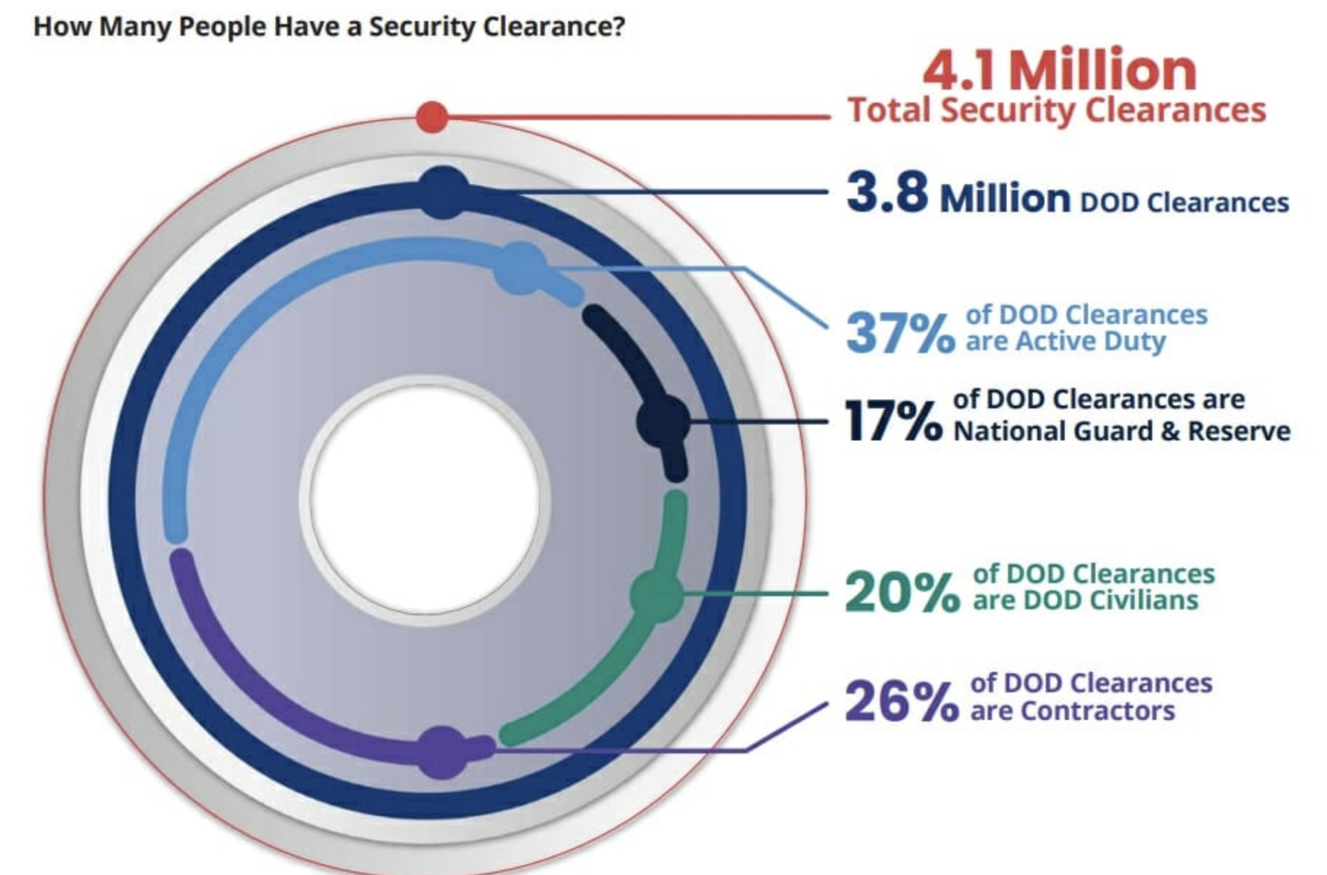
Entry into Intelligence Communities
Security investigations are inquiries about a potential candidate by means of questioning a person’s background and personal life
For confidential documents, security checks are carried out, such as reference checks, covert, and overt investigations, e.g. questioning neighbours and officials in the residential area, etc.

Slide 65
U.S. Confidential Clearance
Least restrictive clearance. Provides access to information that can cause damage to national security if it is disclosed without authorization
Must be reinvestigated for continued eligibility every 15 years
Requires a National Agency Check, Local Agency Check, and Credit Check (NACLC)

Slide 66

U.S. Secret Clearance
Provides access to information that can cause serious damage to national security if disclosed without authorization
Must be reinvestigated for continued eligibility every 10 years and requires NACLC and a Credit investigation

Slide 67
U.S. Top Secret Clearance
This type of security clearance is the most restrictive and provides access to information that can cause grave damage to national security if disclosed without authorization.
Must be reinvestigated for continued eligibility every 5 years.
Typically granted after a Single Scope Background Investigation (SSBI), for data related to counterterrorism, counterintelligence, and other extremely sensitive information.

Slide 68
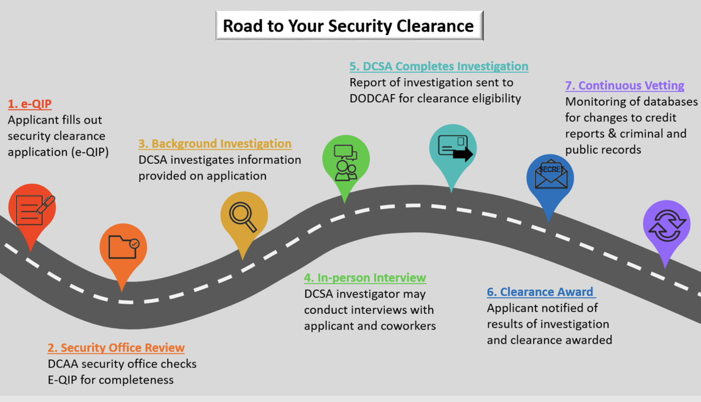

Slide 69
Disqualifiers
Not a citizen of the United States.
Have been dishonorably discharged from military service.
Currently involved in the use of illegal drugs.
Prior security clearance has been revoked for security concerns.
Judged as mentally incapacitated by a mental health professional.
Criminal charges and blemishes on your financial history, such as unpaid bills
Any of which is deemed a plausible reason to reject applications to the relevant epistemic community

Slide 70
Group Exercise
Gather into small groups and reflect on intelligence agencies as epistemic communities
In particular, given the goals of epistemic communities I would like you to research and reconstruct justification for the noted disqualifiers for obtaining U.S. security clearance, e.g. how might financial problems undermine community goals?
We will discuss as a group

Slide 71
Summary
We have outlined portions of an analytic toolkit which will prepare us for more sophisticated discussions of intelligence analysis
Toolkit topics covered include:
Knowledge & Justified Belief
Pragmatic Encroachment
Epistemic & Normative Defeaters
Epistemic Communities

Slide 72
Readings
National Security Intelligence Activity: A Philosophical Analysis
Rethinking Intelligence Practices and Processes

